Slide 1
Intelligent Driving System
PowerGrid Engineering, LLC
Progress Energy Inc.
Group 3
Celina Martin
James Kies
Mike Jones
Yazen Ghannam

Slide 2
Goals
High Efficiency
Intelligent Control System
Reliable Operation
Battery Capacity Monitoring
User Friendly Interface
Touch Screen

Slide 3
Objectives
Intelligent Driving System
Designed to be applicable to any size electric vehicle
Current sensing
Voltage sensing
Three modes of operation
Performance Mode
Normal Mode
Economy Mode

Slide 4
Specifications
3.2” touchscreen with 320 x 240 resolution
Current Sensors for Battery/Motor
40mV/A
Current Sensors for Solar Panel
100mV/A
120VAC/12VDC Converter
16VDC Solar panel capable of charging one 12VDC battery

Slide 5

Mechanical System
F150 Power Wheels
Two rear wheel motors
Operating Speeds
0-2.5 mph
0-5 mph
Plastic chassis
User Max Weight
140lbs

Slide 6
Electrical System
Power Supplies
12VDC Battery
Supplies power to all other electronics
Solar Panel
Charges the 12VDC battery
Battery Management System (BMS)
Senses various parameters of the Battery Pack

Slide 7
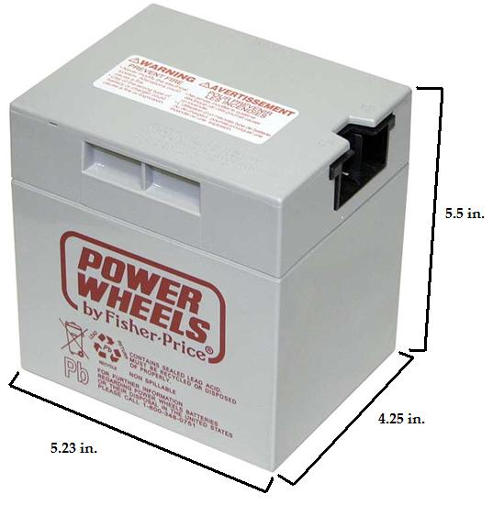
Electrical System
Battery Specifications
Sealed Lead Acid
Voltage: 12VDC
Capacity: 9.5Ah
Weight: 10lbs

Slide 8
Electrical System
Solar Power

Slide 9
Electrical System
Battery Management System
Discharge Rate
State of Charge
State of Discharge
Depth of Discharge
Temperature

Slide 10
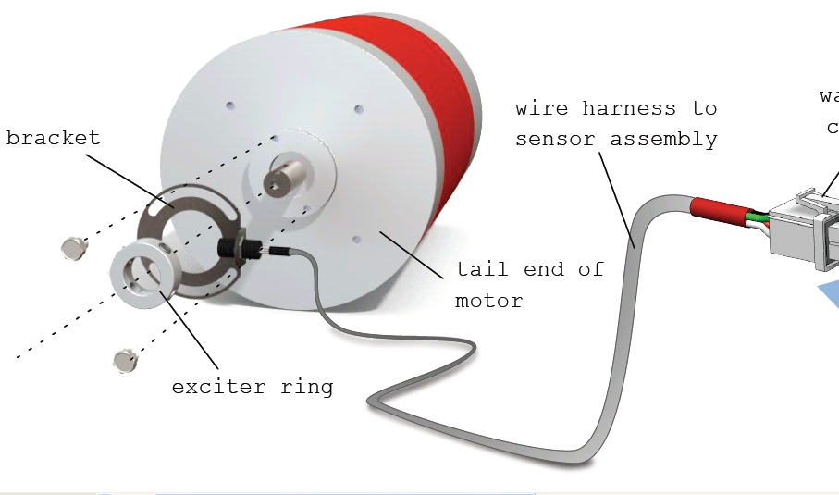
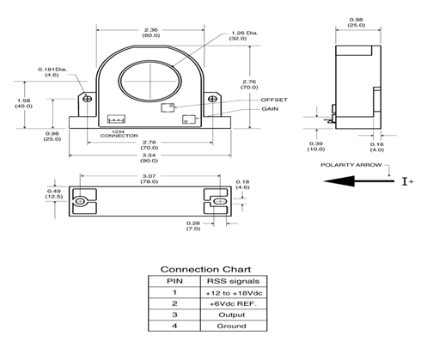
Electrical System
RPM/Motor Current Sensors
Hall effect ring has four symmetrically placed sensors attaches to motor shaft to measure motor rotational speeds.
The RPM will be displayed on the touch screen to allow driver to know when to shift gears because electric vehicles don’t have engine noise to know when to shift.
Current used to measure the +/- 500 amps of motor and battery current is the F.W. Bell RSS-200-A Hall Effect sensor. The sensor has a linearity over the +/-200A range and can also measure current up to +/- 500A with some minor non-linearity effects. The output sensitivity is 8mV/A centered around a 6VDC reference voltage.

Slide 11
Electrical System
Sensor /Motor Controller
Microchip PIC32 Microcontroller
16 Digital temperature sensor inputs
10 Bit A/D
PWM output
Digital Outputs
Digital Inputs
Filters and Voltage conversion
Output DAC
SPI communication Bus
Debug ports
Notes:
Microchip PIC32 Microcontroller will be used to interface between all of the sensors
and provide motor control functions. Power calculation will be completed before passing
to other micro
16 digital temp sensor inputs will be interrupt driven
Ten 10 Bit A/D inputs for voltage and current measurements
1 channel PWM output for controlling motor speed
Multiple digital outputs for controlling fans, solenoids ,etc.
They drive an interface IC that connects to MOSFETS transistors that switch 12 volt power
Digital inputs for motor RPM, Vehicle Speed sensor
Filtering and voltage regulators and convertors 2.5V REF, 3.3, 5 and 6 volt ref
Output DAC for controlling existing purchased motor drive electronics
SPI Bus to communicate with Touch Screen Microcontroller
Debug ports for integration activities

Slide 12
Electrical System
Sensor /Motor Controller
DC Motor Drive
IXYS Low Side Drive
- IXDN414Y
IXYS IGBT transistors
- IXGK320N60B3
Motor Protection Diode
- MURTA60060R
Difference Amplifier
- AD629BRZ
Bulk Capacitance
Current Sensing
- LT1111
- RSS-200-A
Notes:
DC Motor Drive will require PWM switching of 144Vdc at up to 500 amps .
The PWM switching frequency will be around 15Khz. The Drive does not require a full H bridge
Design because the motor only has to rotate in one direction
Low side drive will be accomplished by an IXYS IXDN414Y high current switch.
It is capable of switch large amounts of capacitance at frequencies greater than 200kHz
Utilizes three IXYS IXGK320N60B3 IGBT’s connected in parallel to help distribute
power load. The IGBT’s are 500V at 320A each and can be switched at up to 25Khz
Motor will contain protection diode MURTA60060R across to limit the voltage
rise when IGBT’s are switched off
AD629BRZ Analog device Difference amplifier with High common mode input
range up to 300Vdc for measuring motor voltage
Bulk capacitors will supply located close to motor to supply instantaneous
current during motor switching and low impedance sink for motor EMF because wires
coming from batteries will have some inductance. This should help reduce EMI emissions
Current sensing will be accomplished by using and LT1111 amplifier that measures
the output of the F.W. Bell RSS-200-A Hall Effect sensor

Slide 13
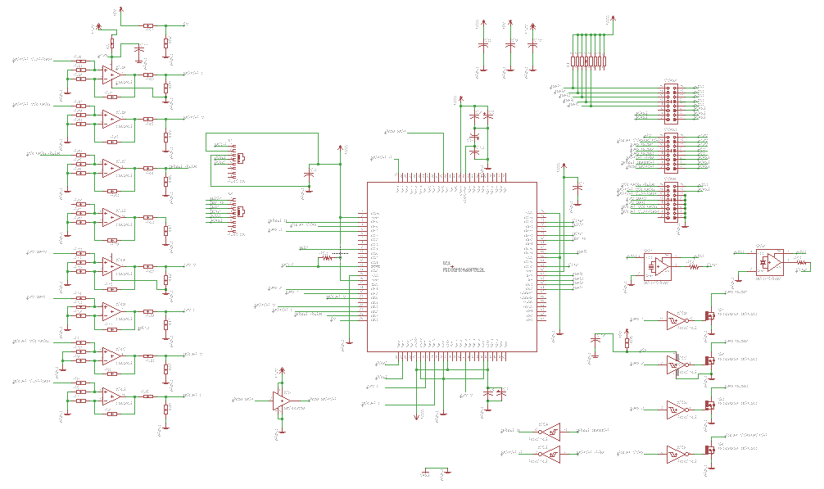
Electrical System
Sensor /Motor Controller
Schematic of Sensor/Motor Controller for PowerWheels vehicle
Notes:
Preliminary Schematic of Sensor/ Motor Controller. The circuit card is currently being
Updated to add filters, and new voltage regulators along with additional connectors for debug.

Slide 14
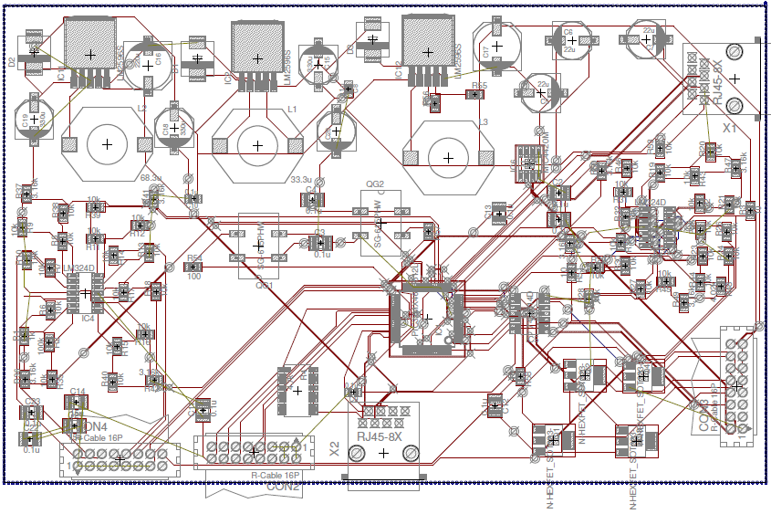
Electrical System
Printed Circuit Board

Slide 15
Electrical System
Issues
Noise
Additional Filtering
Impedance Shielded Cable
Temperature
Heat Sinking
Designed Motor Drive Electronics
Notes:
Potential Issues
Noise The Large switching power >50Kwatts required to drive the motor is
anticipated to generate severe noise. The electronics on both circuit card assemblies
will have filtering to try and alleviate some of this noise but until the car is
assembled and operating the amount will have to be measured .
Temperature sensors will require impedance controlled wire with shields to help reduce
EMI pickup
IGBT Power Dissipation-The IGBTs that have to handle up to 500 amps at 144 volts. The
50 watts of power
dissipation will require a good conduction path to the auto structure along with fans to handle
full power operation
Purchased vs. Designed Motor Drive Electronics. Tradeoff between using existing motor drive
electronics that the sponsor has purchased versus using our design will be determined after
the initial testing of the automobile. The most efficient design one will be used.
Incorporate Voltage Pedal into Motor Drive Electronics with 3 modes of operation
If we use existing motor drive electronics then incorporating the voltage pedal and controlling
the 3 modes of operation will be more difficult then using our own design. Will not be able
to determine finalize the design until after initial testing.
10 bit AD’s may not be enough resolution for the large dynamic range
of the motor and battery currents. There range is +/-500amps which results in around
1 Amp resolution. May have to add an 12 bit A/D for better resolution

Slide 16
Electrical System
Temperature Sensors
Options
Analog
One wire technology
Digital
Part Number | Type | Temp. Range | Input Voltage | Output | Cost
LM335 | Analog | -40°C to +100°C | 1.8V to 5.5V | Voltage | $1.35
TMP20 | Analog | -55°C to +130° | 1.8V to 5.5V | Voltage | $0.87
TMP03 | Digital | -40°C to +100°C | 4.5V to 7V | Open Collector | $5.04
TMP04 | Digital | -40°C to +100°C | 4.5V to 7V | CMOS/TTL | --
DS18S20 | 1-Wire | -55°C to +125°C | N/A | Digital 9-bit | $4.00
DS18B20 | 1-Wire | -55°C to +125°C | N/A | Digital 12-bit | $4.00
Notes:
For thermal monitoring several temperature sensors will be placed throughout the vehicle, mainly on the batteries and microcontroller, where most of the heat will be generated. There were three options of temperature sensors consisting of either analog, digital or one wire that we could possibly use. The benefits of analog sensors would be the overall cost required, the one wire sensor would decrease the number of wires strung throughout the vehicle in wiring harness and finally our selection would be the digital sensor which would eliminate the need to MUX the readings and also is an open collector device.

Slide 17
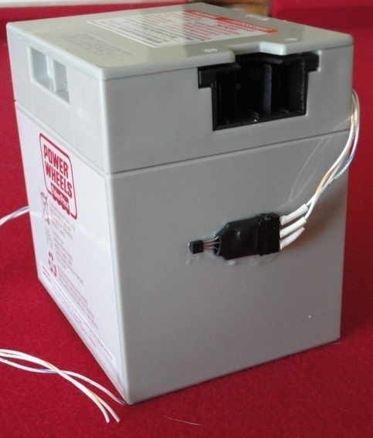
Electrical System
Temperature Sensors
TMP03 Digital Temp Sensor
Input voltage: 5VDC
Accuracy of 1.5°C
Interface
3.3kΩ pull up resistor
TMP03
TMP03
TMP03
TMP03
Sensor/Motor Controller
User Interface
LCD Display
Notes:
The TMP03 digital temperature sensor will have an input voltage of 5VDC and will measure with a 1.5 degree Celsius accuracy. To interface with our sensor/motor microcontroller a 3.3k Ohm pull up resistor will be used. In the block diagram you can see that each battery along with the microcontroller will have a digital temperature sensor fed to the sensor/motor controller which will then be interfaced to the user interface where it can not only be displayed for the user to see on the LCD display but can also be compared for a fan to turn on. Depending upon whether the vehicle is in economy mode or not this turn on point may be altered for a higher temperature range. These values will be continually monitored to turn off the fan once the temperature has decreased to save battery power.

Slide 18
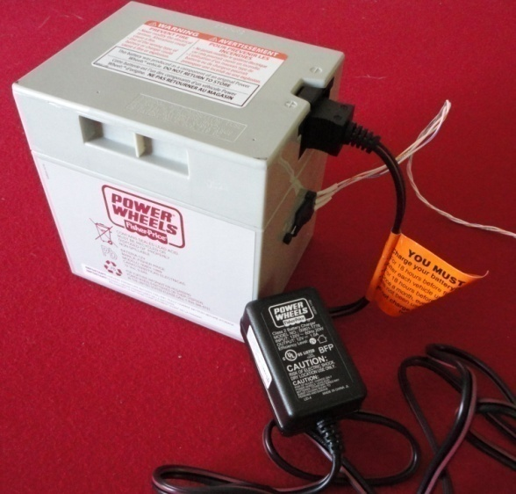
Electrical System
Power Converters
AC/DC Power Converter (Battery Charger)
Specifications
Input Voltage: 120VAC
Output Voltage: 12VDC
Lead-Acid Compatible
Standard Power Wheels Fisher-Price Class 2 Battery Charger
Notes:
In order to charge the batteries in the rear of the vehicle a AC/DC Power converter also known as a battery charger will be used. The input voltage is equal to 120VAC, the standard wall outlet voltage, and the output is 144VDC as set by the battery pack and motor selected. This converter must be set for lead-acid charging and is greater than 90% efficient.

Slide 19
Electrical System
Power Converters
Small DC/DC Power Converters
12VDC -> 5VDC
Temperature Sensors, Hall Effect Sensors
12VDC -> 3.3VDC
Microcontroller A/D inputs
Linear Regulator
High Heat Waste
Low Efficiency
Low Cost
Switching Regulator
Low Heat Waste
High Efficiency
Medium Cost
Notes:
A couple of small DC/DC step down power converters were designed for the vehicle. A 12VDC/5VDC buck converter was designed to provide power to all the temperature sensors throughout the vehicle and a 12/3.3 buck converter is used for the microcontroller A/D inputs. We selected to use switching regulators for these in order to decrease heat and improve efficiency at a medium cost increase.

Slide 20
Electrical System
Power Converters
LM2596 Simple Switcher Step Down Power Converter
+/- 4% tolerance
150kHz switching frequency
Additional components (L,C) selected from datasheet
Notes:
The LM2596 Simple switcher step down power converter was selected for its 4% tolerance and 150kHz switching frequency. The additional inductor and capacitor components were selected using the provided datasheet

Slide 21
Electrical System
Power Converters
AC/DC – DC/DC Power Conversion Block Diagram
Fisher-Price Battery Charger
12VDC Battery
LM2596 Converter 12VDC/5VDC
LM2596 Converter 12VDC/3.3VDC
Notes:
Here you can see the overall AC/DC-DC/DC power conversion block diagram where 120VAC is being taken in from the wall outlet and interfacing with the 1500W Elcon battery charger. This charger provides 144VDC at 8 amps to the main battery pack and then connections to the 300W HWZ DC/DC converter. 12VDC at 25 amps is then delivered to the 12V auxiliary battery.

Slide 22
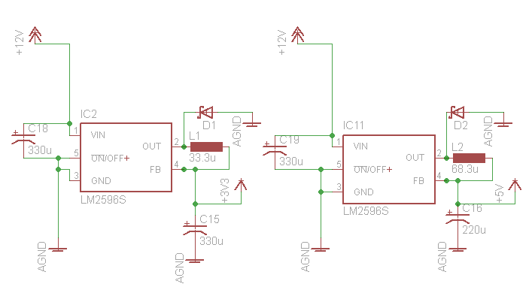
Electrical System
Power Converters
DC/DC Power Conversion Schematic
Notes:
Here you can see the overall AC/DC-DC/DC power conversion block diagram where 120VAC is being taken in from the wall outlet and interfacing with the 1500W Elcon battery charger. This charger provides 144VDC at 8 amps to the main battery pack and then connections to the 300W HWZ DC/DC converter. 12VDC at 25 amps is then delivered to the 12V auxiliary battery.

Slide 23
Computer System
Motor Control
Microchip PIC32
Economy Mode
Independent of user
Based on Battery Voltage (representing the “charge”)
Programmed in C
SPI communication protocol Master Mode
All parameters are read, stored, and formatted then transferred to UI
Issues
Determining the Mode Specifications
Set as constant factor of PWM output
Notes:
Will process efficiency data and set “Economy Mode” as needed independent of user input

Slide 24
Computer System
New User Interface Hardware/Software
Microchip Multimedia Expansion Board
Programmed in C
Designed for Industrial Applications, etc.
Interfaces with PIC32 Starter Kit
Used Microchip Graphics Library Widgets
No way to adjust font size for individual widgets
Had to redo some library code
SPI communication protocol Slave
Used interrupt service routine to read data
Timing is VERY important for SPI
Touchscreen w/ 3.2” QVGA
Sometimes registers wrong clicks
Cost ~$300

Slide 25
Computer System
Old User Interface Hardware
Planar PT1545R 15” Touchscreen LCD Monitor
Large enough to display all required information
Serial/USB interface
Internal Power Supply
Internal Speakers
Open Source Drivers, if needed
Cost ~$420
Fully integrated solution
No need to match touchscreen to monitor
No need to supply touchscreen interface on motherboard
Costs about the same as a non-integrated solution
Possible Issues
Contrast Ratio/Brightness may be an issue in bright outdoor lighting
Glare (includes Anti-Glare coating but this was probably not designed to be used in an outdoor setting)

Slide 26
Computer System
Old User Interface Software
Operating System
Android 2.3
Open Source and freely available
Natively supports touchscreen interfaces
Includes a large widget library
Possible Issues
Touchscreen Drivers are not designed for Android
Linux Drivers are available so it’s possible to port them to Android (Didn’t work since Android is missing X Server)
Slow booting
Remove non-critical components like Bluetooth, 3G, internet, etc.

Slide 27
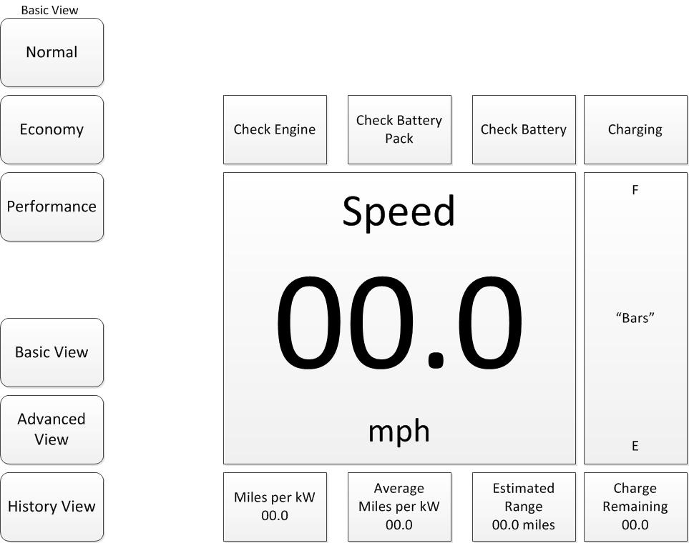
Computer System
User Interface Basic View
Provides basic information, such as engine status, speed, “fuel”, etc.

Slide 28
Project Budget
OLD
Trottle Pedal Assembly | $160.00
Electric Motor | $1,875.00
Motor Controller | $2,050.00
75Ah Sealed Lead Acid | $1,624.35
Temperature Sensor | $100.80
Different Amplifier | $55.28
Current Transformer | $116.34
AC/DC Converter | $340.00
144/12 DC Converter | $125.00
Regulator Simple Swt | $5.18
SMT power inductor-68uH | $0.00
Capacitor 220uF | $5.00
Diode-Schottky | $1.48
Capacitor 330uF | $1.12
Solar Charger | $185.00
DC Contactor | $169.00
ESTOP | $24.06
Solar controller | $34.95
Roof Base Rack | $243.52
Grand Total | $7,116.08
New budget following project reduction to small vehicle.
NEW
F150 PowerWheels Vehicle | $319.00
Electronics | $800.00
Display | $330.00
Breakout Boards and Development Cards | $300.00
Grand Total | $1,749.00
Notes:
Here is the overall bill of materials for the car conversion with a total budget of 7,116 dollars.

Slide 29
Project Development
December
January
Plans
Original Project Description
PowerGrid LLC
DC Motor Design
Problems
No Car Available
Plans
PowerGrid request for AC motor design
Ford Taurus Purchased
Problems
Automatic Transmission
Heavy Vehicle for fully electric
Notes:
Our current project status is at 95% research, 75% design, 10% prototype and 5% testing.

Slide 30
Project Development
February
March
Plans
Original Project Description
PowerGrid LLC
DC Motor Design
Volkswagen Golf Manual Transmission Purchased
Problems
Mechanical Aspects and Transmission to be worked on by external contact
Plans
Switched from full size vehicle to smaller application
DC Motor Design compatible for any vehicle
Problems
Time
Change design for smaller application
Notes:
Our current project status is at 95% research, 75% design, 10% prototype and 5% testing.

Slide 31
Conclusion
Questions?
Notes:
Our current project status is at 95% research, 75% design, 10% prototype and 5% testing.

